Slide 1

Search Engines and Cloud Computing
Charles Severance

Slide 2
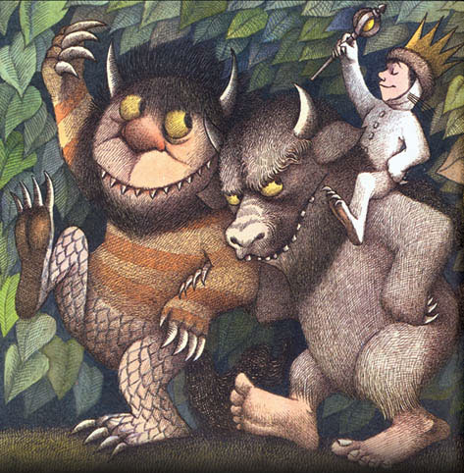
What are the last words of “Where the Wild Things Are”?

Slide 3
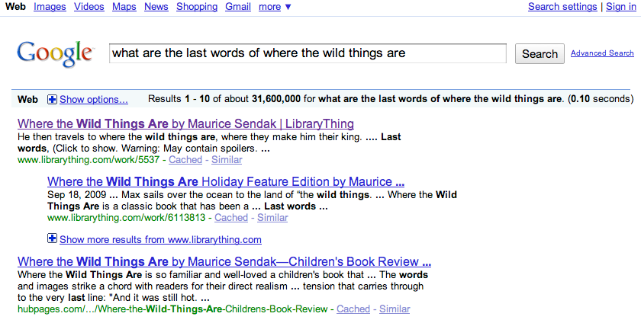

Slide 4
Google

Slide 5
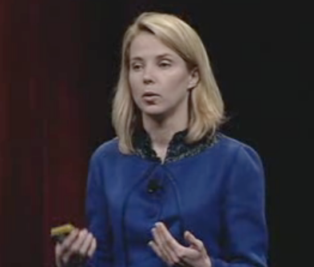
Google I/O 2008 Keynote
Google I/O '08 Keynote by Marissa Mayer
Usablity / User Experience / User Testing / Architecture / Philosophy
Required Viewing
http://www.youtube.com/watch?v=6x0cAzQ7PVs

Slide 6
Lessons
The cloud is wide - we can touch 1000 servers in 0.1 seconds
For things that seem “intelligent” 0.2 seconds is fast enough - as long as you can do a lot of them
Lots of spread-out storage and a fast scan is important
Data - Information - Knowledge - starts with data and the ability to look through that data quickly

Slide 7
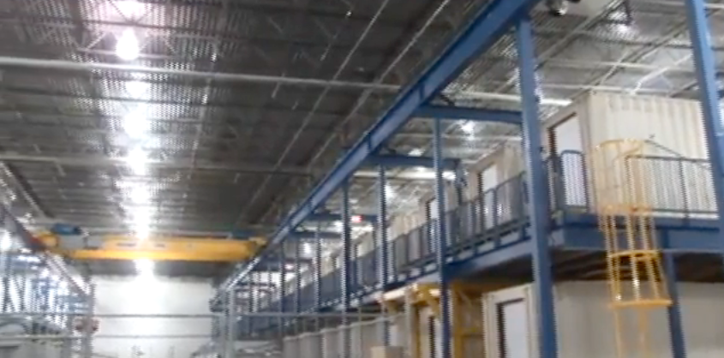
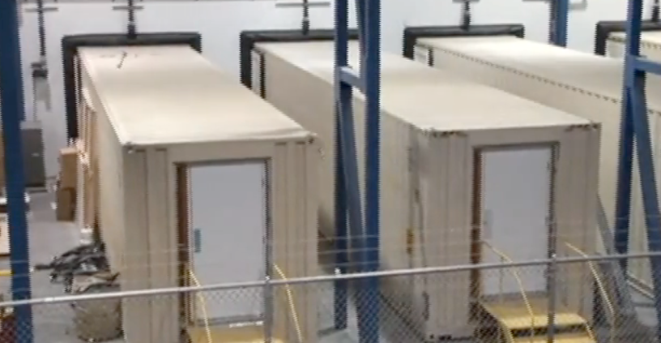
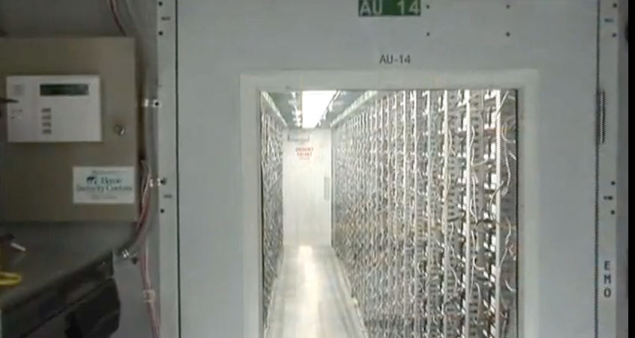
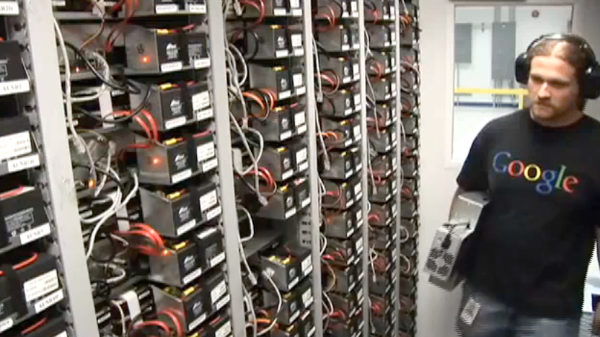
2:50
Scalable
Infrastructure
http://www.youtube.com/watch?v=zRwPSFpLX8I

Slide 8
Infrastructure
The only sustainable scalability is when you scale with inexpensive, green solutions
Tape Backup is a rate limiting factor - so we need something creative
Disaster recovery - “Of course!”

Slide 9
Extracting Knowledge for Search

Slide 10
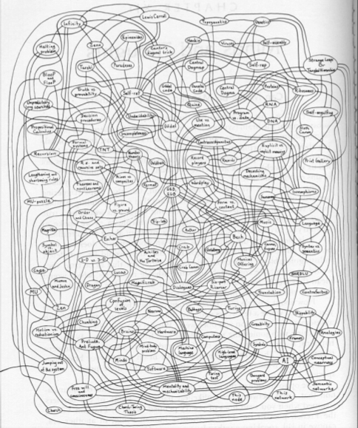
Associative Memory
Humans think in terms of a network and connections of information
As compared to linear lists of things
Like Python Dictionaries (often called Associative Arrays)
http://en.wikipedia.org/wiki/Associative_array

Slide 11
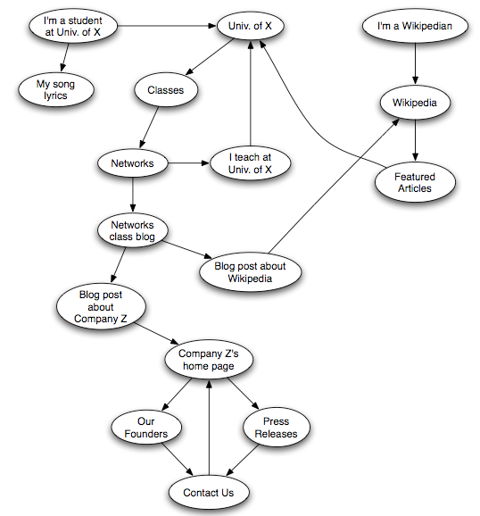
The Web as a Directed Graph
Connectivity - Nodes are linked if there is a series of edges (a path) where you can get from one node to another
“Strongly Connected” - there is a path from every node to every other node in a graph

Slide 12
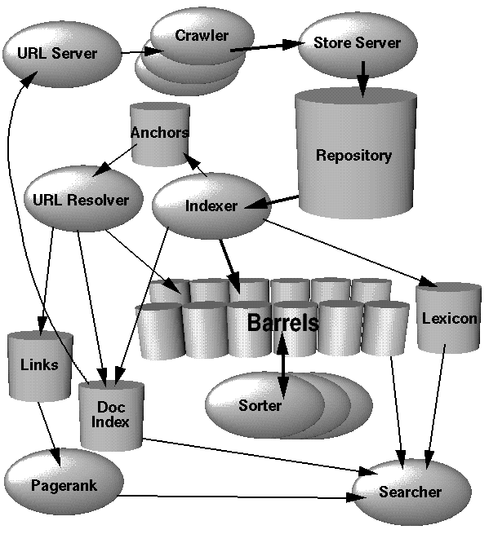
Search Engine Architecture
Web Crawling
Index Building
Searching
http://infolab.stanford.edu/~backrub/google.html

Slide 13
Web Crawler
A Web crawler is a computer program that browses the World Wide Web in a methodical, automated manner. Web crawlers are mainly used to create a copy of all the visited pages for later processing by a search engine that will index the downloaded pages to provide fast searches.
http://en.wikipedia.org/wiki/Web_crawler

Slide 14
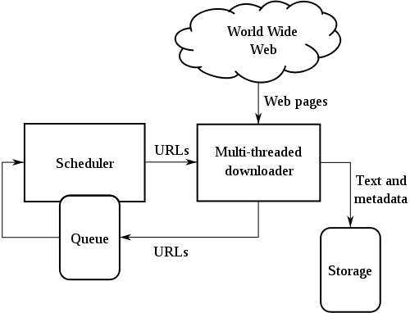
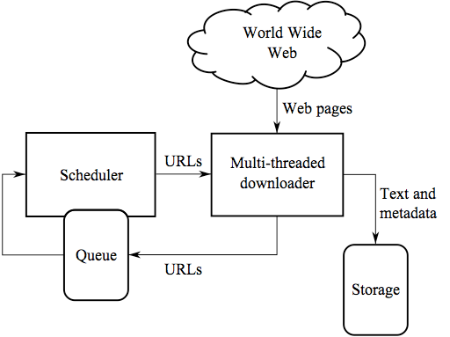
Web Crawler
Retrieve a page
Look through the page for links
Add the links to a list of “to be retrieved” sites
Repeat...
http://en.wikipedia.org/wiki/Web_crawler

Slide 15
Web Crawling Policy
a selection policy that states which pages to download,
a re-visit policy that states when to check for changes to the pages,
a politeness policy that states how to avoid overloading Web sites, and
a parallelization policy that states how to coordinate distributed Web crawlers
http://en.wikipedia.org/wiki/Web_crawler

Slide 16
robots.txt
A way for a web site to communicate with web crawlers
An informal and voluntary standard
Sometimes folks make a “Spider Trap” to catch “bad” spiders
User-agent: *
Disallow: /cgi-bin/
Disallow: /images/
Disallow: /tmp/
Disallow: /private/
http://en.wikipedia.org/wiki/Robots_Exclusion_Standard
http://en.wikipedia.org/wiki/Spider_trap

Slide 17
Google Architecture
Web Crawling
Index Building
Searching
http://infolab.stanford.edu/~backrub/google.html

Slide 18
Search Indexing
Search engine indexing collects, parses, and stores data to facilitate fast and accurate information retrieval. The purpose of storing an index is to optimize speed and performance in finding relevant documents for a search query. Without an index, the search engine would scan every document in the corpus, which would require considerable time and computing power.
http://en.wikipedia.org/wiki/Index_(search_engine)

Slide 19
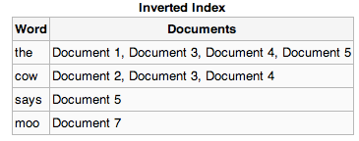
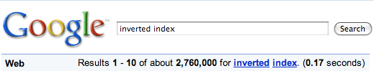
Inverted Index
An Inverted Index lists all of the documents which contain a particular word
Allows us to quickly produce a list of documents given one or a few search terms
The problem with the web is that we have too many documents
http://en.wikipedia.org/wiki/Inverted_index

Slide 20
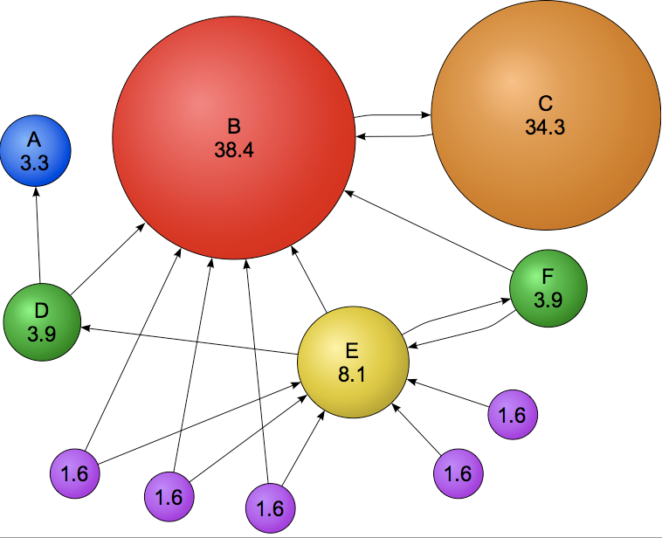
PageRank
Basic Idea: Incoming links signal “value” or “interest”
Incoming links from other high ranking sites have greater value
Computed by giving all sites some “value” and letting value flow out the outboud links and in the inbound links until value stabilizes
http://en.wikipedia.org/wiki/PageRank

Slide 21
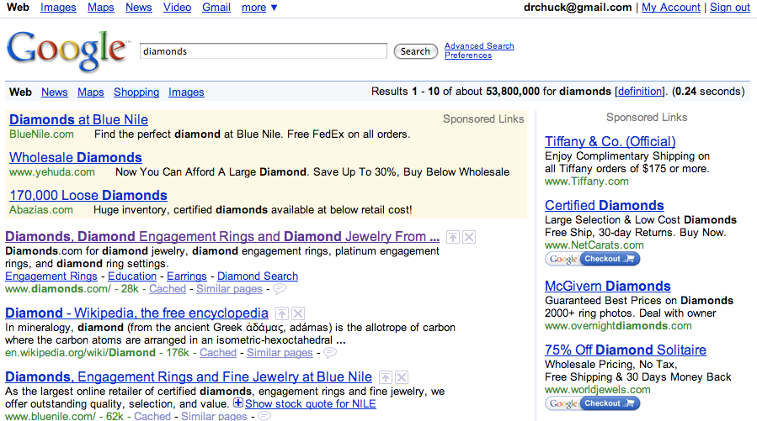

Free and
very
valuable
http://en.wikipedia.org/wiki/Search_engine_optimization

Slide 22
Gaming Google
The real ranking mechanism has many subtle tuning parameters which are kept secret as well as human intervention
Once the web site builders *know* the rules - they can game the system
A busy little consultancy - Search Engine Optimization (SEO)

Slide 23
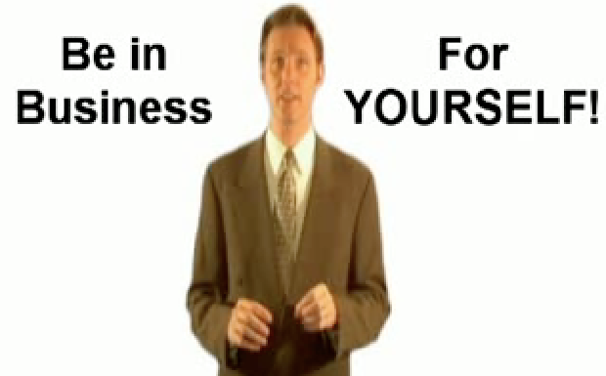
Google Supplemental Index
Not a good place to be - crawling happens less frequently and seldom appear in search results
Causes: duplicate content, low page rank, link manipulation, page freshness, etc.
“Google uses the index as a holding pen for pages it deems to be of low quality or designed to appear artificially high in search results.”
http://en.wikipedia.org/wiki/Supplemental_Result

Slide 24
Search Engine Optimization
Very dangerous and Google has rules
Google will put your site on “supplimental index” for as long as a year
Google “Google Hell”
“Google uses the index as a holding pen for pages it deems to be of low quality or designed to appear artificially high in search results.”
http://www.forbes.com/2007/04/29/sanar-google-skyfacet-tech-cx_ag_0430googhell.html

Slide 25
Google’s Webmaster Central
Lets you work with Google’s crawler and index with regards to your site
You establish ownership of a site by adding a meta-tag
You can look at crawling activity, page rank, set up a site map, etc.
http://www.google.com/webmasters/

Slide 26
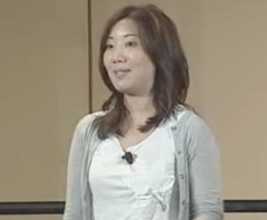
Search-Friendly Web Development
Google I/O
Maile Ohye (Google) - June 10, 2008
Mission: Organize the world’s information and make it universally accessible and useful
http://www.youtube.com/watch?v=NIWtZPIf4Nk

Slide 27
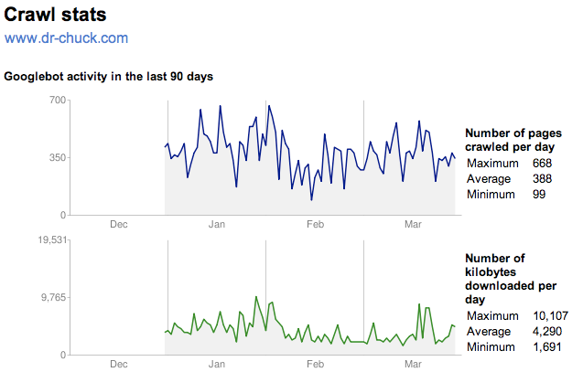
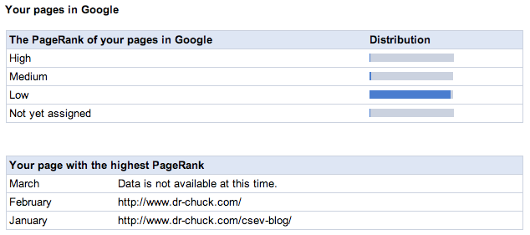
http://www.google.com/webmasters/

Slide 28
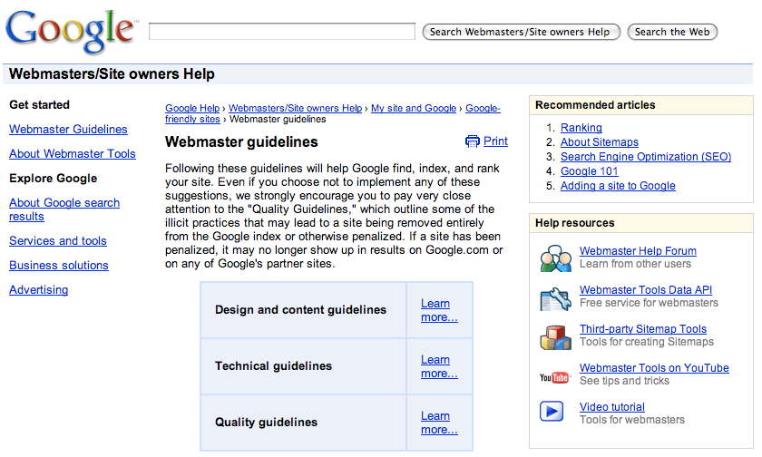
Webmaster Guidelines
Content design
Search Engine Optimization
Technical Issues
http://google.com/support/webmasters/bin/answer.py?answer=35769

Slide 29
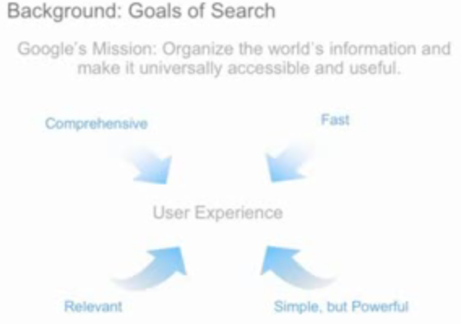
Search-Friendly Web Sites
What should you do to ensure your site works well for Google Search (alt tags, title, description, url design)
How can your site get in trouble?
Google’s focus on “User Experience” and Usability and how they feel when your site is clicked from a search that it reflects on them
http://www.youtube.com/watch?v=NIWtZPIf4Nk

Slide 30
Make a site with a clear hierarchy and text links. Every page should be reachable from at least one static text link.
Offer a site map to your users with links that point to the important parts of your site. If the site map is larger than 100 or so links, you may want to break the site map into separate pages.
Create a useful, information-rich site, and write pages that clearly and accurately describe your content.
Think about the words users would type to find your pages, and make sure that your site actually includes those words within it.
http://www.google.com/support/webmasters/bin/answer.py?answer=35769

Slide 31
Try to use text instead of images to display important names, content, or links. The Google crawler doesn't recognize text contained in images. If you must use images for textual content, consider using the "ALT" attribute to include a few words of descriptive text.
Make sure that your <title> elements and ALT attributes are descriptive and accurate.
Check for broken links and correct HTML. Keep the links on a given page to a reasonable number (fewer than 100).
If you decide to use dynamic pages (i.e., the URL contains a "?" character), be aware that not every search engine spider crawls dynamic pages as well as static pages. It helps to keep the parameters short and the number of them few.
http://www.google.com/support/webmasters/bin/answer.py?answer=35769

Slide 32
Google Architecture
Web Crawling
Index Building
Searching
http://infolab.stanford.edu/~backrub/google.html

Slide 33
Search Queries
A web search query is a query that a user enters into web search engine to satisfy his or her information needs. Web search queries are distinctive in that they are unstructured and often ambiguous; they vary greatly from standard query languages which are governed by strict syntax rules.
http://en.wikipedia.org/wiki/Search_engine_indexing

Slide 34
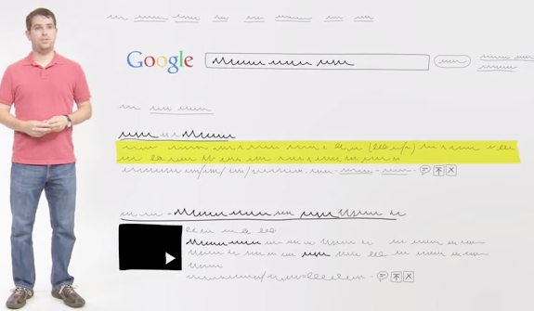
How Search Works
http://www.youtube.com/watch?v=BNHR6IQJGZs

Slide 35
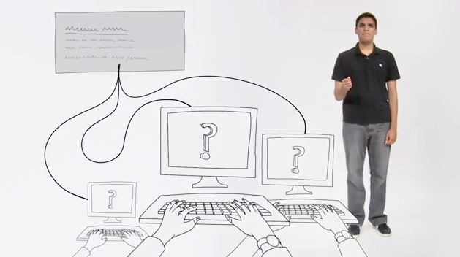
How Search Ads Work
http://www.youtube.com/watch?v=ka4tCkYXHiE

Slide 36
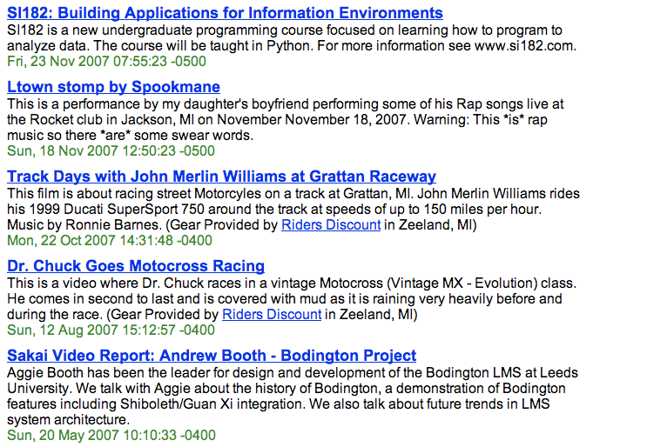
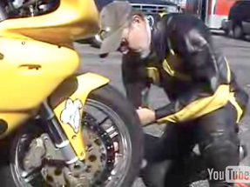
PageRank Story

Slide 37
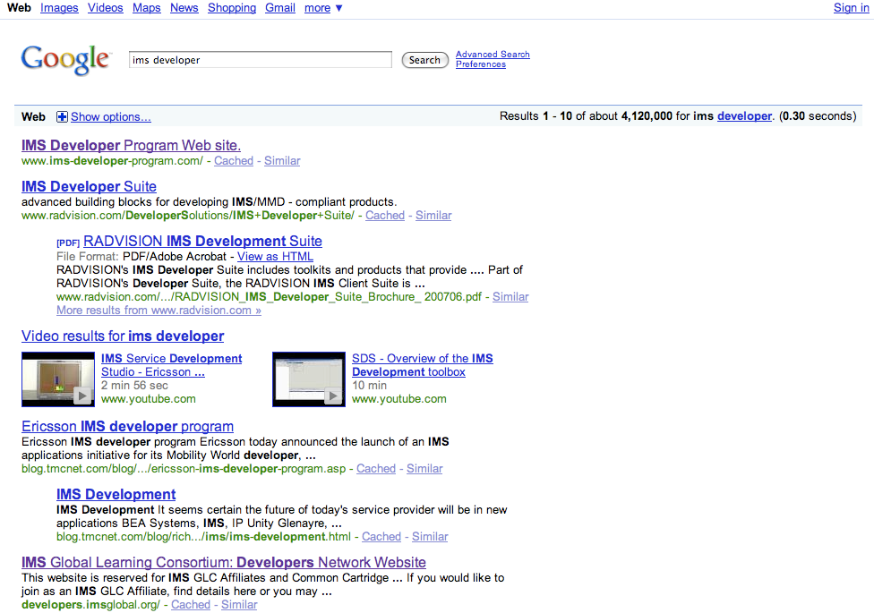
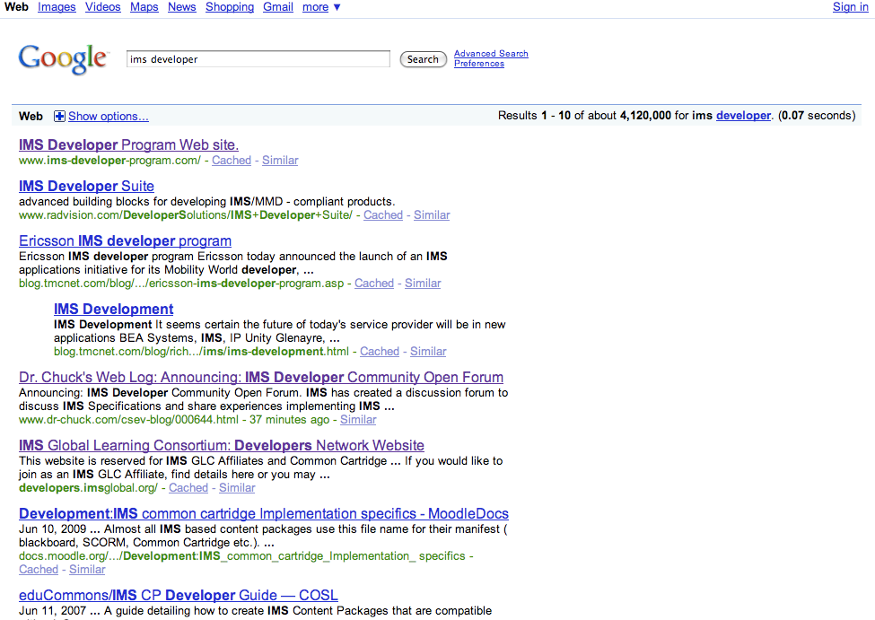
What PageRank Gets You
July 25, 2009 11:15 PM
July 25, 2009 11:55 PM

Slide 38
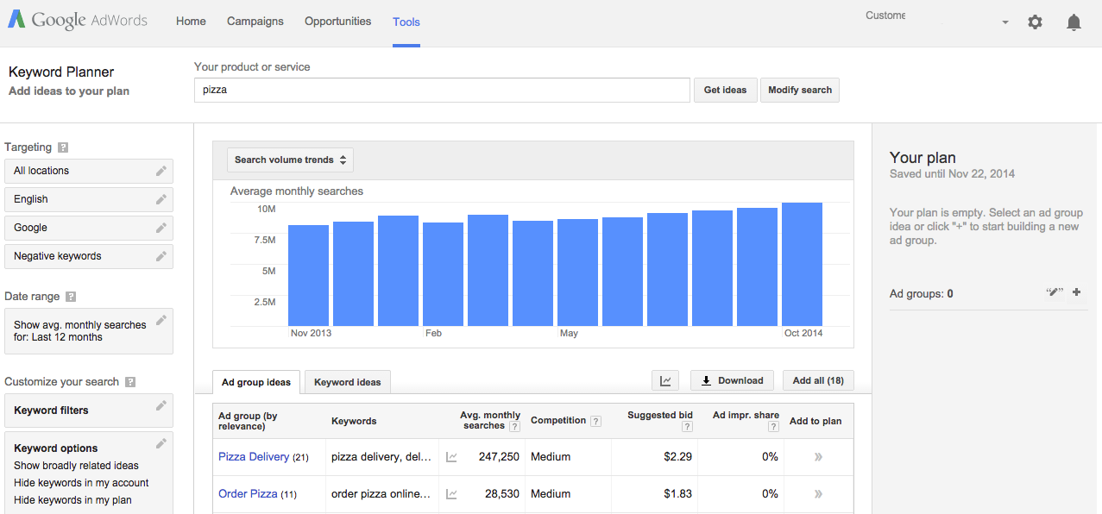
Google Keyword Tool
https://adwords.google.com/
Allows you to explore different keywords and see approximate prices

Slide 39
Search Summary
Web Crawling
Index Building
Searching
Advertising
http://infolab.stanford.edu/~backrub/google.html

Slide 40
Advanced Topics (not required)
http://infolab.stanford.edu/~backrub/google.html
http://video.google.com/videoplay?docid=7278544055668715642 --- Big Table

